Slide 1
Tutorial 1 The Economic Approach

Slide 2
Question 4
Joe’s problem is depicted below.

Slide 3
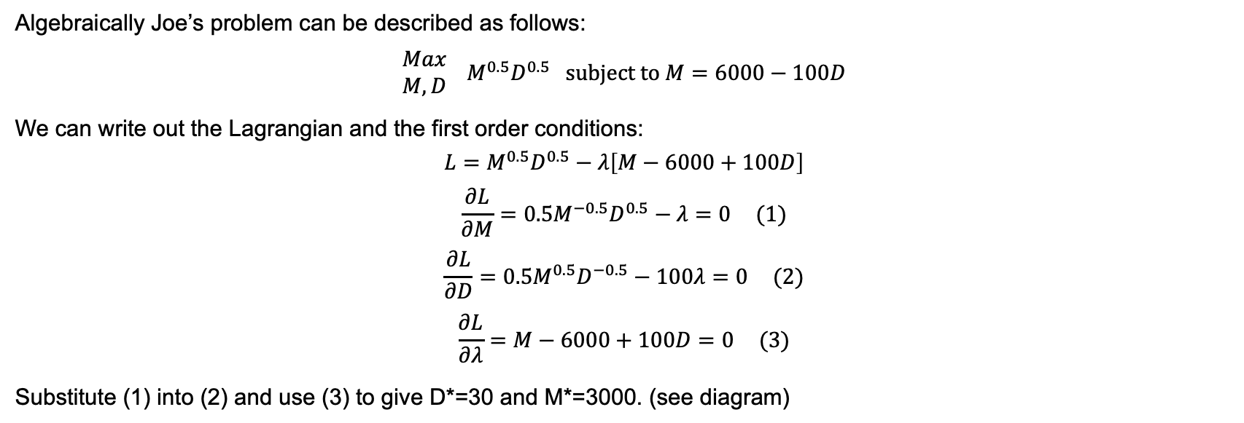
Question 4
Algebraically Joe’s problem can be described as follows:
$$\begin{matrix}Max \\ M,D\end{matrix} M^{0.5}D^{0.5} \text{subject} \text{to} M=6000−100D$$
We can write out the Lagrangian and the first order conditions:
$$L=M^{0.5}D^{0.5}−λ\left[M−6000+100D\right]$$
$$\frac{∂L}{∂M}=0.5M^{−0.5}D^{0.5}−λ=0 (1)$$
$$\frac{∂L}{∂D}=0.5M^{0.5}D^{−0.5}−100λ=0 (2)$$
$$\frac{∂L}{∂λ}=M−6000+100D=0 (3)$$
Substitute (1) into (2) and use (3) to give D*=30 and M*=3000. (see diagram)

Slide 4
Question 4
Joe’s problem is depicted below.

Slide 5
Question 4
The pay schedule changes.

Slide 6
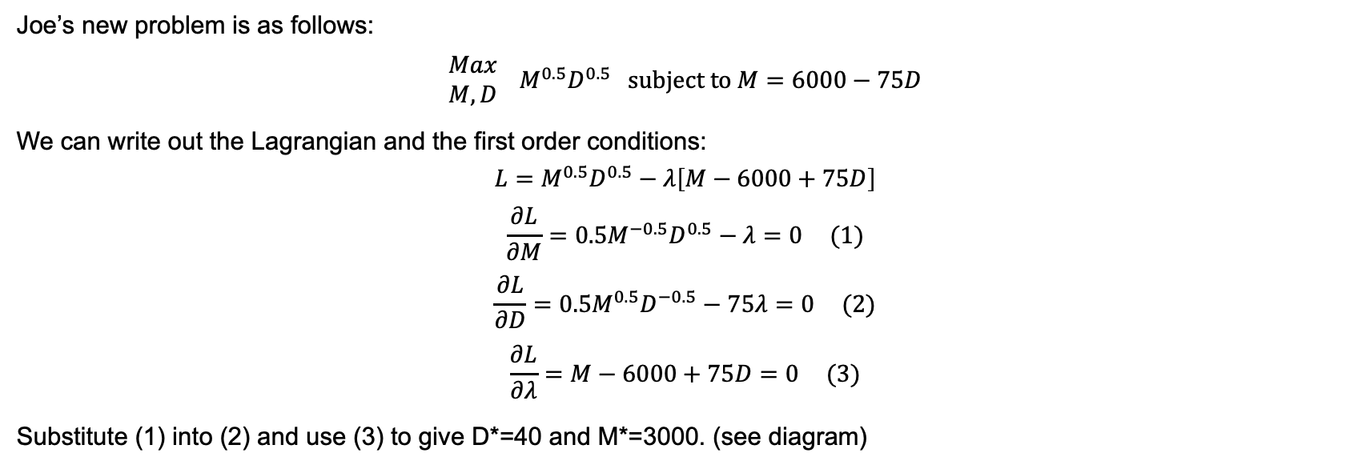
Question 4
Joe’s new problem is as follows:
$$\begin{matrix}Max \\ M,D\end{matrix} M^{0.5}D^{0.5} \text{subject} \text{to} M=6000−75D$$
We can write out the Lagrangian and the first order conditions:
$$L=M^{0.5}D^{0.5}−λ\left[M−6000+75D\right]$$
$$\frac{∂L}{∂M}=0.5M^{−0.5}D^{0.5}−λ=0 (1)$$
$$\frac{∂L}{∂D}=0.5M^{0.5}D^{−0.5}−75λ=0 (2)$$
$$\frac{∂L}{∂λ}=M−6000+75D=0 (3)$$
Substitute (1) into (2) and use (3) to give D*=40 and M*=3000. (see diagram)

Slide 7
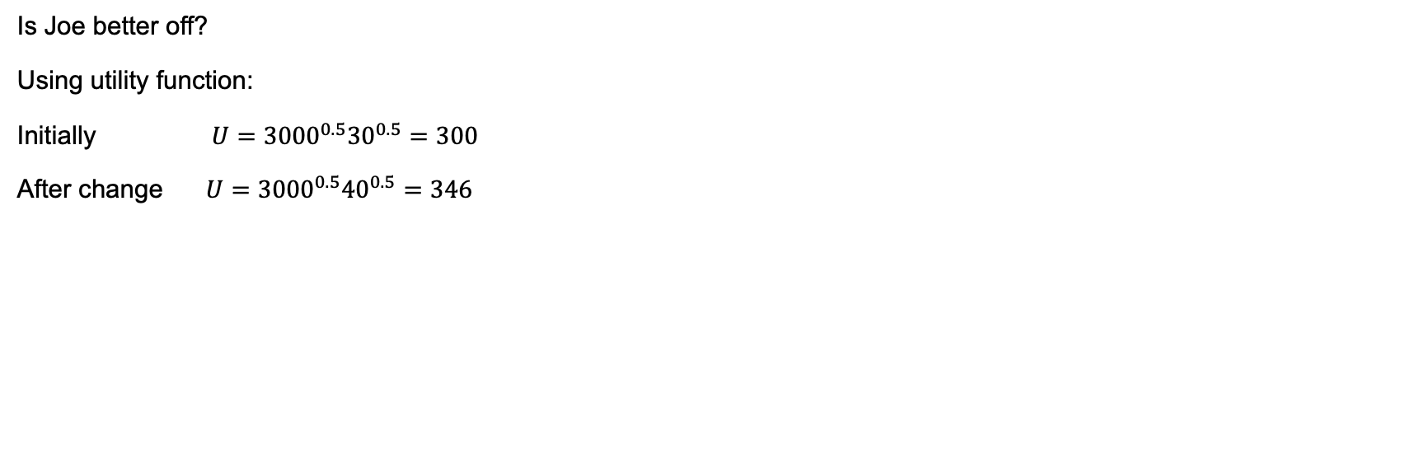
Question 4
Is Joe better off?
Using utility function:
Initially $U={3000}^{0.5}{30}^{0.5}=300$
After change $U={3000}^{0.5}{40}^{0.5}=346$

Slide 8
Question 4
What if Joe only cared about money:

Slide 9
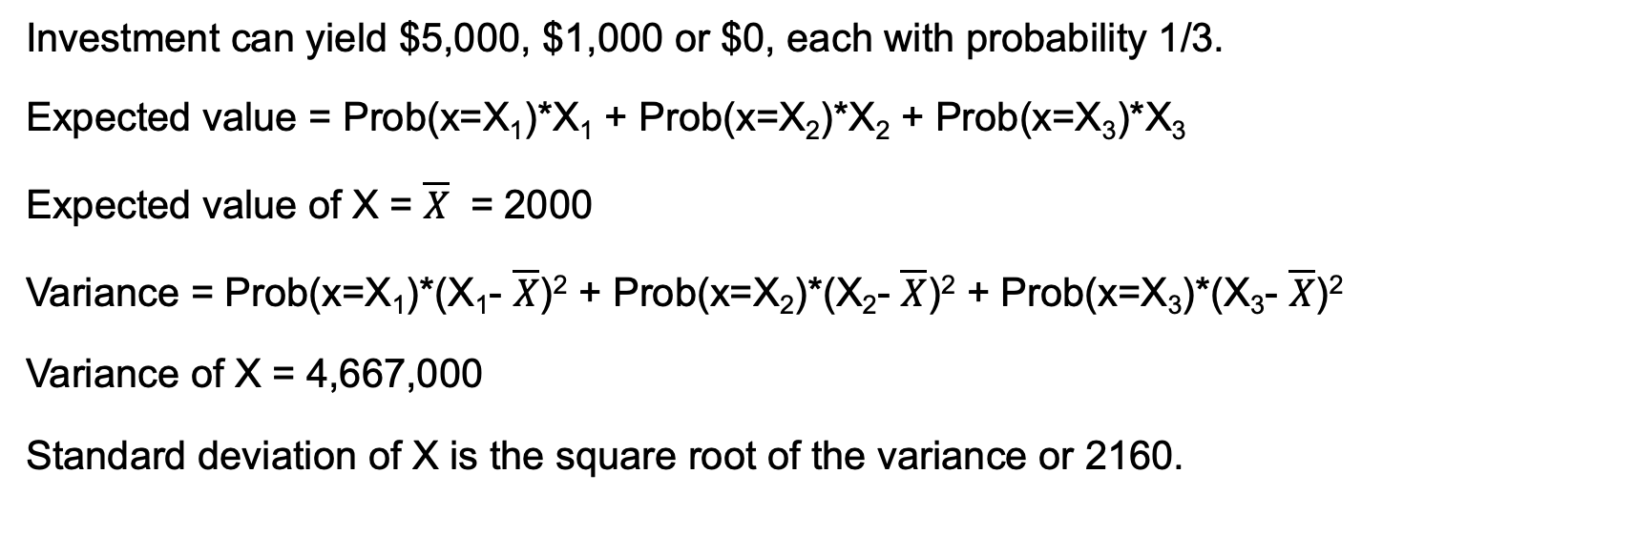
Question 5
Investment can yield $5,000, $1,000 or $0, each with probability 1/3.
Expected value = Prob(x=X₁)*X₁ + Prob(x=X₂)*X₂ + Prob(x=X₃)*X₃
Expected value of X = $\overline{X}$ = 2000
Variance = Prob(x=X₁)*(X₁- $\overline{X}$)² + Prob(x=X₂)*(X₂- $\overline{X}$)² + Prob(x=X₃)*(X₃- $\overline{X}$)²
Variance of X = 4,667,000
Standard deviation of X is the square root of the variance or 2160.

Slide 10
Question 6
Jenny is an investor in the stock market. She cares about both the expected value and standard deviation of her investment. Currently she is invested in a security that has an expected value of $15,000 and a standard deviation of $5,000. This places her on an indifference curve with the following formula: Expected Value = $10,000 + Standard Deviation.
Is Jenny risk averse? Explain.
What is Jenny’s “certainty equivalent” for her current investment? What does this mean?
What is the risk premium on her current investment?

Slide 11
Question 6
Jenny’s indifference curve.

